Slide 1
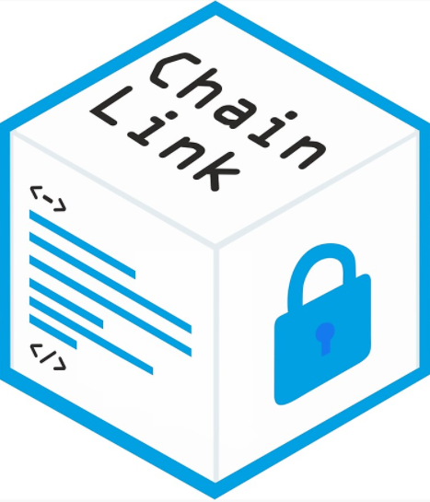

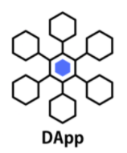
Advanced Topics: Oracles and Upgradable Contracts
Loke KS

Slide 2
Reference
Gavin Zheng, Longxiang Gao, Liqun Huang, Jian Guan. Ethereum Smart Contract Development in Solidity. Springer Nature Singapore. 2021. https://doi.org/10.1007/978-981-15-6218-1
https://docs.openzeppelin.com/upgrades-plugins/1.x/proxies

Slide 3
Upgradeable Contract
When smart contracts are deployed into the Ethereum blockchain, they are immutable and therefore, not upgradable.
Once you create them there is no way to alter them, effectively acting as an unbreakable contract among participants.
However, in the real world, we may need to modify contract code due to various reasons: fixing bug, modifying business logic, upgrading functionality, etc. After

Slide 4
Migration
The most obvious way will be something like this:
Create & deploy a new version of the contract.
Manually migrate all states from the old contract to the new contract.
This seems to work, but has several problems.
Migrating the contract state can be expensive.
As we create & deploy a new contract, the contract address will change. So you would need to update all contracts that interacted with the old contract to use the address of the new version.
You would also have to reach out to all your users and convince them to start using the new contract and handle both contracts being used simultaneously, as users are slow to migrate.

Slide 5
Approach
Strategy for an upgradeable contract can be classified into four categories:
Proxy contracts
Separate logic and data
Separate logic and data through key-value pair
Partially upgrade

Slide 6
Proxy Contracts
The main thought of proxy contract is to call the function in target contract through delegatecall opcode and target contract is upgradeable.
Since delegatecall keeps working on the context of caller function, the target contract code is able to update the status of Proxy contract and keep the result in proxy contract.

Slide 7
Separate Logic and Data Contracts
The main idea is to put all contract data (variable, struct, mapping, etc.) and its related getter and setter function into data contract; and put all business logic related code (possibly modify contract data) into a logic contract.
So, even though business logic changes, data is still in the same location. This method allows the full upgrade of logic contract.
Contract can ask users to use new logic contract (through ENS parser), and adjust data privilege to run getter and setter function.

Slide 8
Separate Logic and Data Through Key-Value
This method is similar to previous method.
The only difference is data access is abstracted and is through key-value pair via sha256 hash algorithm and standardized naming system.

Slide 9
Partially Upgradeable Strategies
Creating a fully upgradable contract could cause a severe trust problem: immutability of contract. So in many situations, the partial upgradeable design is also popular.
Partial upgrade means that core functionality is not upgradeable, while other parts are upgradeable.
Example: Ethereum Name Service “ENS”:

Slide 10
Ethereum Name Service “ENS”:
ENS contract is a simple contract and un-changeable. Domain registration contract is a factory contract. Domain registration can be upgraded by administrators.
Registration contract for “.eth” is a factory contract. When switching to a new domain manager, the contract is upgraded by linking to the old contract.

Slide 11
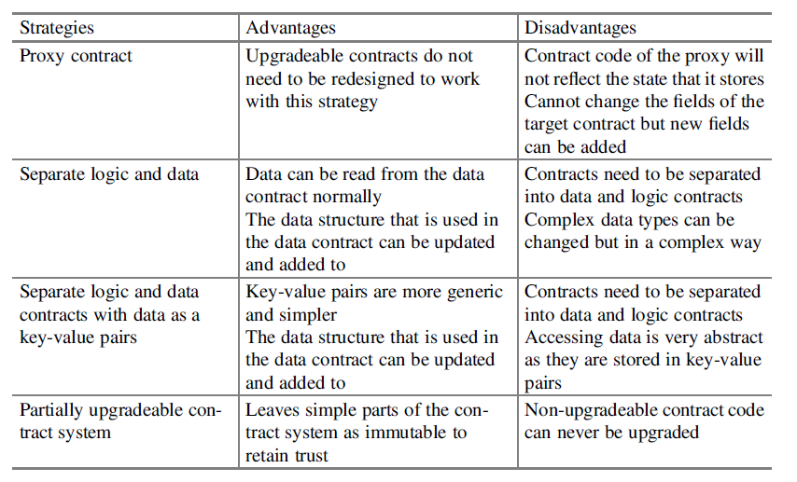
Summary

Slide 12
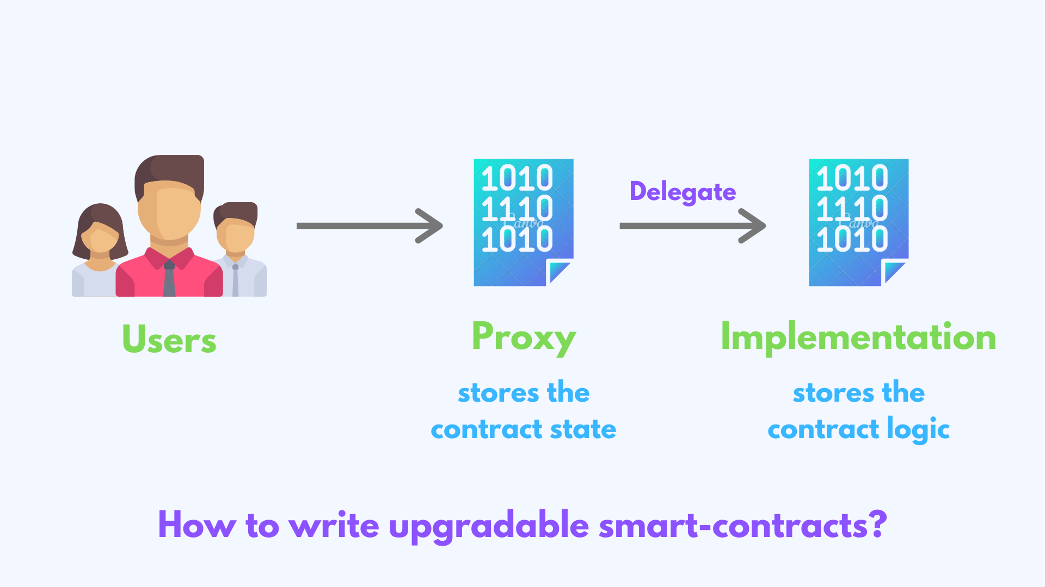
Proxy Delegate Call
A better way is to use a proxy contract with an interface where each method delegates to the implementation contract (which contains all the logic).
https://simpleaswater.com/upgradable-smart-contracts/

Slide 13
Proxy Delegate Call
We basically split the contract into a Proxy and Implementation contract. The proxy calls the Implementation contract by a delegate call.
A delegate call is similar to a regular call, except that all code is executed in the context of the caller (proxy), not of the callee (implementation). Because of this, a transfer in the implementation contract’s code will transfer the proxy’s balance, and any reads or writes to the contract storage will read or write from the proxy’s storage
This approach is better because the users only interact with the proxy contract and we can change the implementation contract while keeping the same proxy contract.

Slide 14
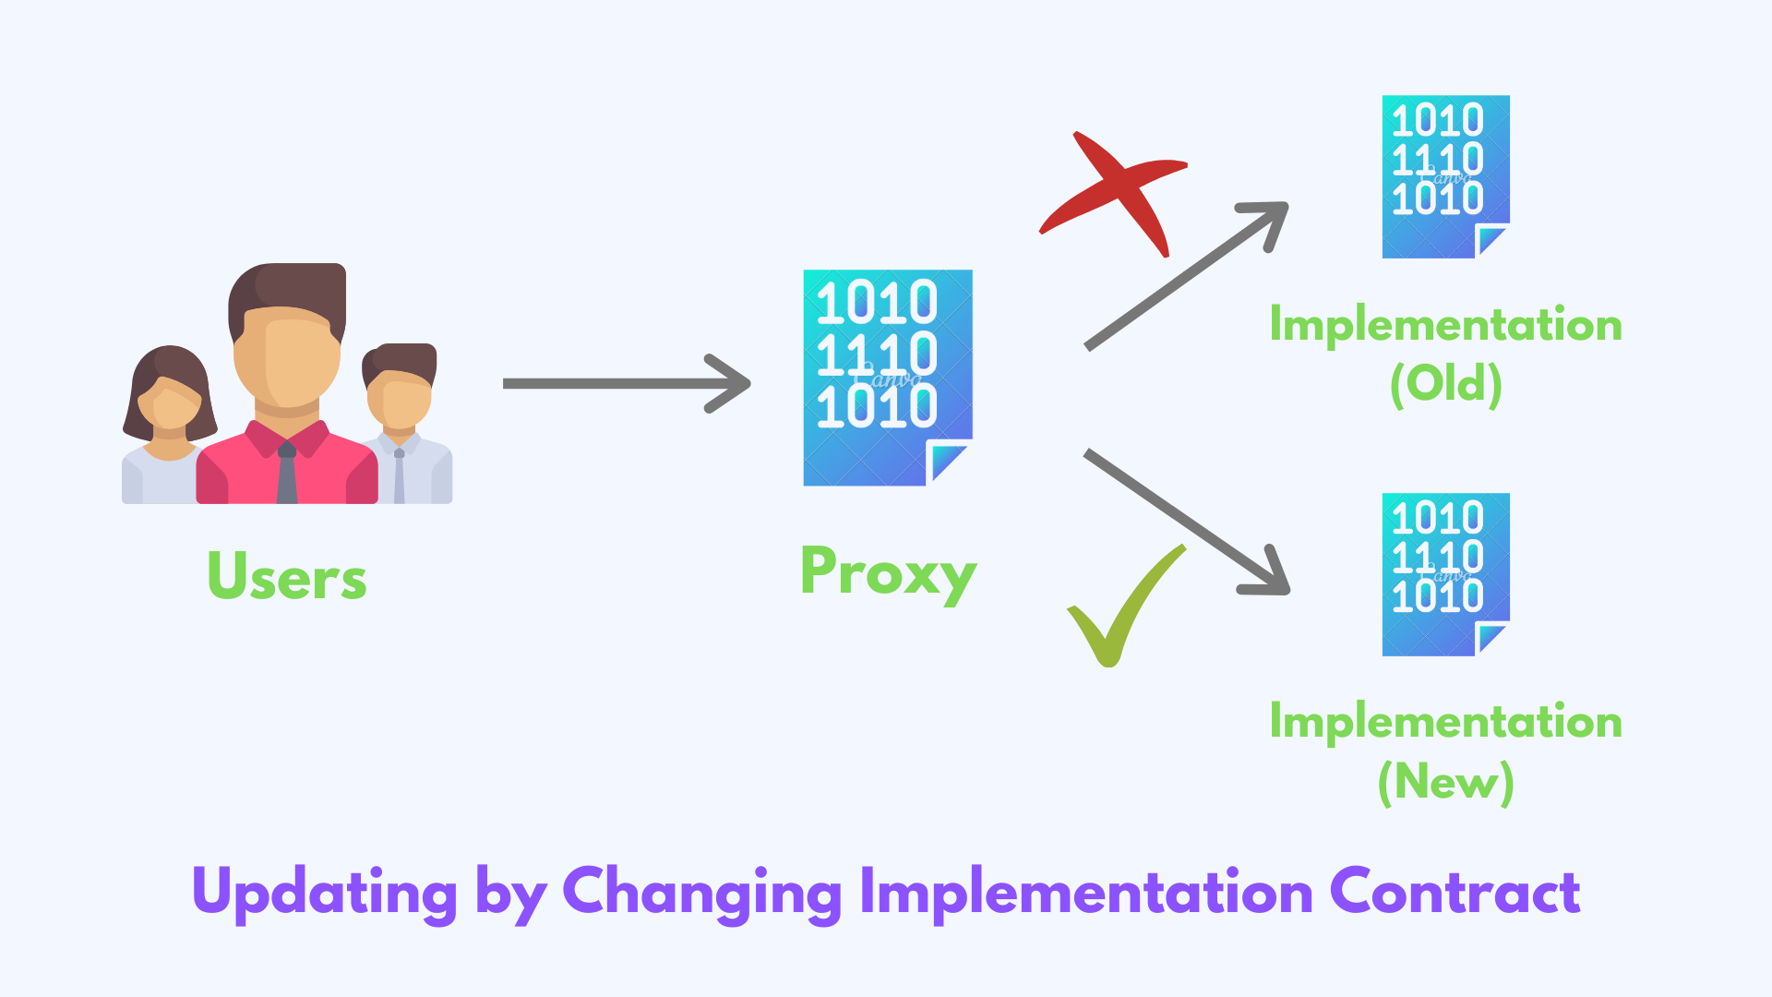
Proxy Delegate Call
if we need to make any changes to the implementation contract methods, we would need to update the proxy contract's methods too
Hence, users will need to change the proxy address.

Slide 15
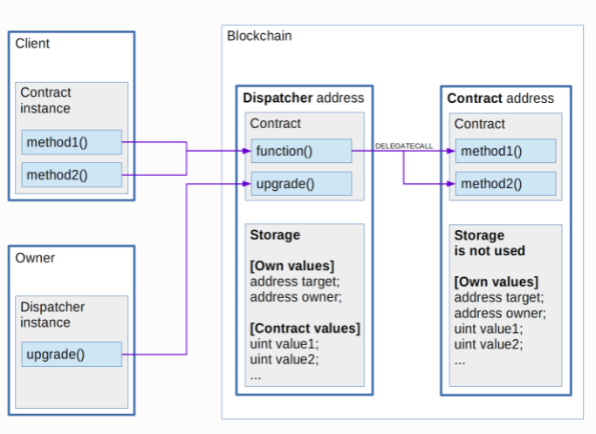
Proxy Delegate Call
https://docs.nucypher.com/en/latest/architecture/upgradeable_proxy_contracts.html
The Dispatcher contract uses delegatecall for redirecting requests, so msg.sender remains as the client address and uses the dispatcher’s storage when executing methods in the target contract.

Slide 16
Proxy Issues
In the upgradeable contract:
No constructors. Workaround: Use Initializer function
No initialization of state variables. Workaround: Use Initializer function
Can’t create new Contract instances. You need to inject them in.
State variables order and type must be the same, can’t add new variables

Slide 17
Transparent Proxies
Proxies need some functions of their own, such as upgradeTo(address) to upgrade to a new implementation.
How do we determine if this call is meant to be delegated to the implementation contract?
Upon a call to that function, did the caller intend to call the proxy or the logic contract?
A transparent proxy will decide which calls are delegated to the underlying logic contract based on the caller address (ie the msg.sender)
https://docs.openzeppelin.com/upgrades-plugins/1.x/proxies

Slide 18
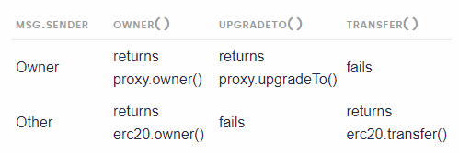
Transparent Proxies
f the caller is the admin of the proxy (the address with rights to upgrade the proxy), then the proxy will not delegate any calls, and only answer any messages it understands.
If the caller is any other address, the proxy will always delegate a call, no matter if it matches one of the proxy’s functions

Slide 19
What’s the oracle problem?
Blockchains cannot interact with off-chain data without interfering with the consensus protocol (the process by which a distributed system forms a single state of truth).
Interacting with off-chain data can lead to multiple states of the blockchain ledger.
Today, the main use of smart contracts is tokenization, the process of issuing ownership rights to real-world assets or utility in the form of a token.
Tokenization exploded from 2017-2018, raising an estimated 20 billion dollars. One of the primary reasons for the growth of tokenization is that it doesn’t require off-chain data.
https://blog.chain.link/oracles-the-key-to-unlocking-smart-contracts/

Slide 20
On Chain / Off Chain
All the token information is already known and stored on-chain, in the blockchain smart contract.
On the contrary, most smart contracts for industries such as derivatives, insurance, and trade finance need external off-chain data such as IoT data, market data, and events data to trigger execution.
This trigger data is not stored on the same blockchain as the initial smart contract, because it is simply neither realistic nor practical to do so. Most of the world's data exists off-chain.
The current lack of connectivity between off-chain and on-chain systems means the new and existing worlds cannot interact with each other.

Slide 21
On Chain / Off Chain
The second challenge facing today’s smart contracts is that smart contracts cannot push outputs onto external systems. For example, smart contracts cannot execute payments in fiat currencies on traditional payment systems.
The truth is that smart contracts that are unaware of what is happening in the off-chain world and unable to communicate with existing legacy systems are neither smart nor functional enough for real-world adoption.

Slide 22
Issue with Blockchain
Since the blockchain has its distributed ledger nature, each node in the network has to be able to find the same end result given the same input.
Otherwise, when a node looks to validate a transaction another node makes, it would end up with a different result. This architecture is intentional, and it’s designed to be deterministic intentionally.
However if the blockchain wants to access external data (off chain), it will call an API. However it can’t be assured that each node will receive the same results from the API call.

Slide 23
Issue with Blockchain
If they call the API even an instant later, the API could have changed — been depreciated, hacked, or for a number of other reasons — and all the nodes would get a different result.
This means none of the nodes would be able to agree upon what the actual state of the blockchain is.
If you include API calls or other non-deterministic sources into the infrastructure of blockchain, there is a good chance that the source will be depreciated, hacked, or even just broken, and we would not be able to validate transactions.
Therefore the API call may not be deterministic and there won’t be concensus.

Slide 24
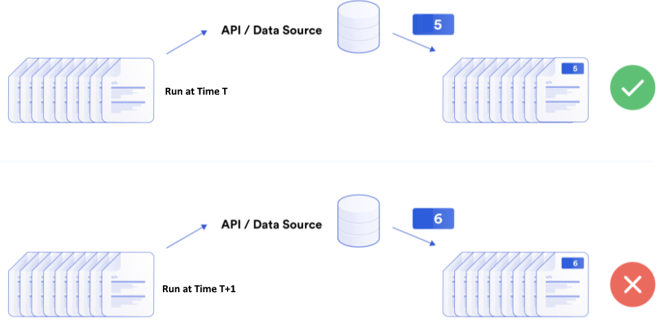
Issue with Blockchain

Slide 25
Oracles
A blockchain oracle is a middleware that creates a secure connection between smart contracts and various off-chain resources that they need to function.
A oracle is any device or entity that connects a deterministic blockchain with off-chain data.
An API is a defined way to communicate with a particular system and varies in design from system to system.
There are three oracle models: oracles coded from scratch by and for a particular entity, centralized oracles, and decentralized oracles

Slide 26
Centralized oracle
A third party private company fetches and feeds data into the smart contract. While this service can be useful, the smart contract needs to trust that this single company will not be compromised.
Oracles trigger smart contracts, and there must be significant faith invested in one private company to determine the outcome of valuable, time-sensitive contracts.
A centralized oracle is hacked, attacked, outdated, or not maintained,
When a centralized infrastructure is used for oracles, smart contracts lose their key features of being trustless

Slide 27
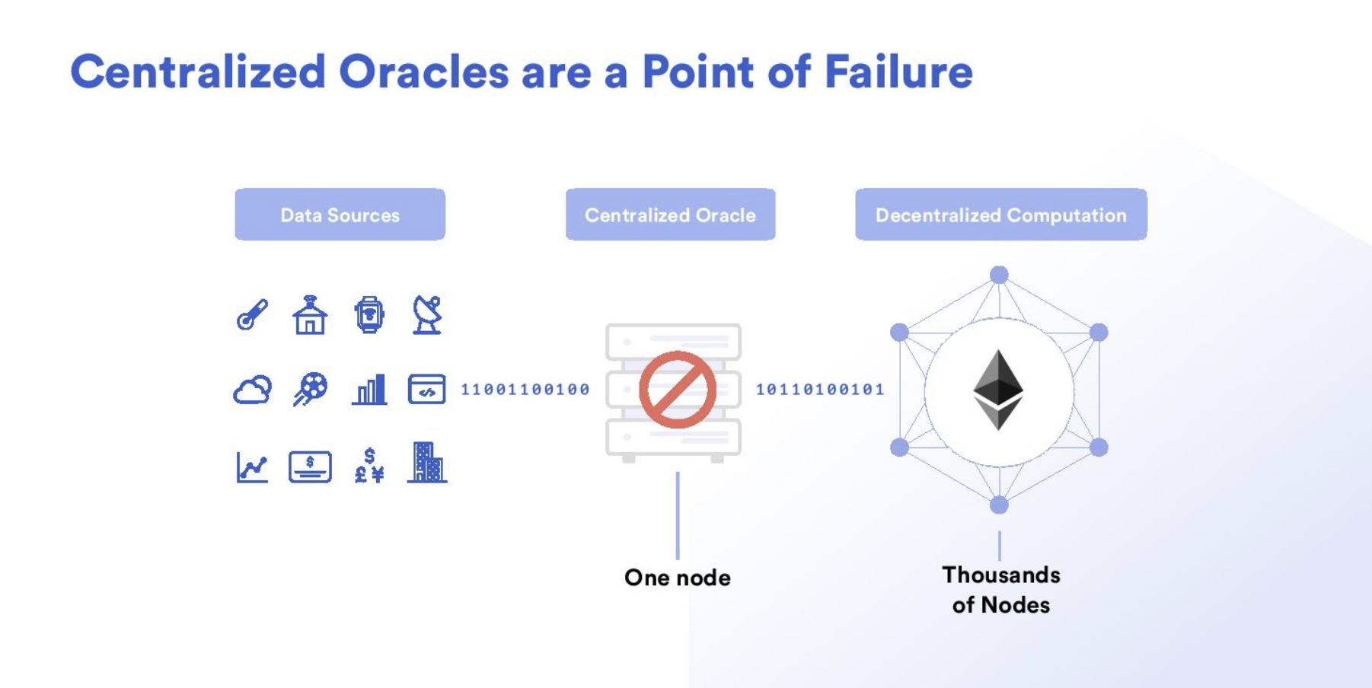

Slide 28
Oracle problem
The oracle problem is these two pieces combined:
Blockchains alone can’t access outside data.
Using centralized oracles nullifies the advantage of smart contracts — and are major security risks.

Slide 29
Decentralized oracle
A decentralized oracle or decentralized oracle network is a group of independent blockchain oracles that provide data to a blockchain.
Every independent node or oracle in the decentralized oracle network independently retrieves data from an off-chain source and brings it on-chain.
The data is then aggregated so the system can come to a deterministic value of truth for that data point. Decentralized oracles solve the oracle problem.

Slide 30
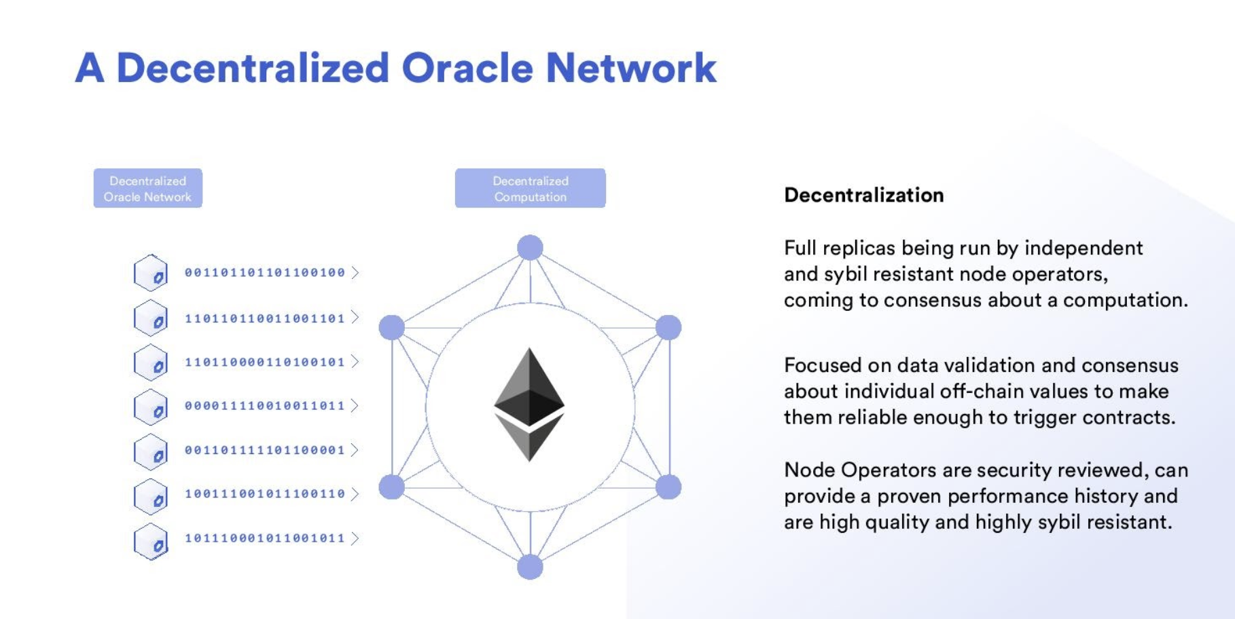

Slide 31
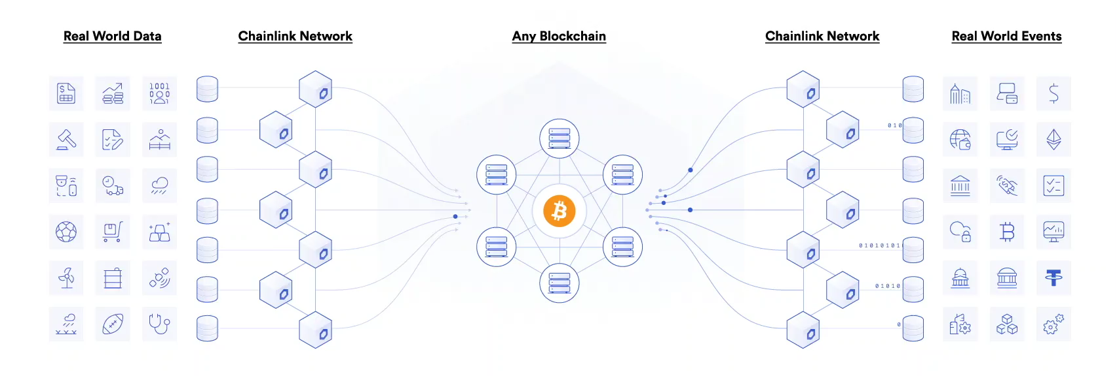
Chainlink, a Decentralized Oracle Network
https://research.chain.link/whitepaper-v2.pdf
https://chain.link/solutions

Slide 32
Generating Random Numbers
The problem stems from the fact that when transactions are mined, they need to be confirmed by more than one node on the network.
This means that every node must come to the same conclusion. So, if a function was truly random, each node would come to a different conclusion, resulting in an unconfirmed transaction.
There have been workarounds that result in a pseudo-random generation, but until now all known methods have been either not truly random, or vulnerable to manipulation
A common approach is to use the block time, sender address, and a nonce to create enough randomness.

Slide 33
Generating Random Numbers
Blockhash-based randomness weakness
Suppose a contract makes decisions based on the parity of the last bit in the hash of the block at a certain height.
This looks like a 50/50 outcome, but consider that a miner (or coalition of miners) who produces one third of the blocks on average may decide to throw out winning blocks for which the last bit of the blockhash is one.
In this case, the miner could bias the zero outcome from a reliable 50% likelihood to a 2/3rds likelihood, leading to the loss of user funds from any smart contract relying on this method of randomness generation

Slide 34
Off Chain Randomness
A random number is generated off-chain and brought on-chain.
However, without cryptographic verification that the off-chain value is unbiased, there’s an opportunity for the result to be manipulated by the off-chain provider and/or by the data transport layer putting that random value on-chain.
Likewise, the application’s users are forced to assume that the randomness is produced fairly and has been brought on-chain without being changed en route to the application.

Slide 35
Use of Randomness
Build reliable smart contracts for any applications that require unpredictable outcomes to:
Make games more trustworthy by using a source of randomness that is verifiable on-chain, allowing developers to provide additional proof to security-sensitive users.
Make games more fun by generating challenging and unpredictable scenarios and environments, and assigning unpredictable player rewards like loot drops.
Generate provably random assignments of duties and resources, e.g. randomly assigning judges to cases or auditors to firms under scrutiny.
Choose a representative sample of observers eligible to vote on a proposal the contract needs to establish consensus for (surveys are an efficient way to provide extra sybil resistance).

Slide 36
Chainlink VRF
In brief, a smart contract requests randomness by providing a seed to Chainlink.
The seed, which should be unpredictable to the oracles it’s being provided to, is used to generate a random number, which is then sent to the contract on-chain.
Each oracle uses its own secret key when generating randomness. When the result is published on-chain along with a proof, it is verified using the oracle’s public key and the application’s seed.
Relying on the widely accepted signature and proof verification capabilities of a blockchain, this enables contracts to consume only randomness that has also been verified by the same on-chain environment running the contract itself
https://blog.chain.link/verifiable-random-functions-vrf-random-number-generation-rng-feature/

Slide 37
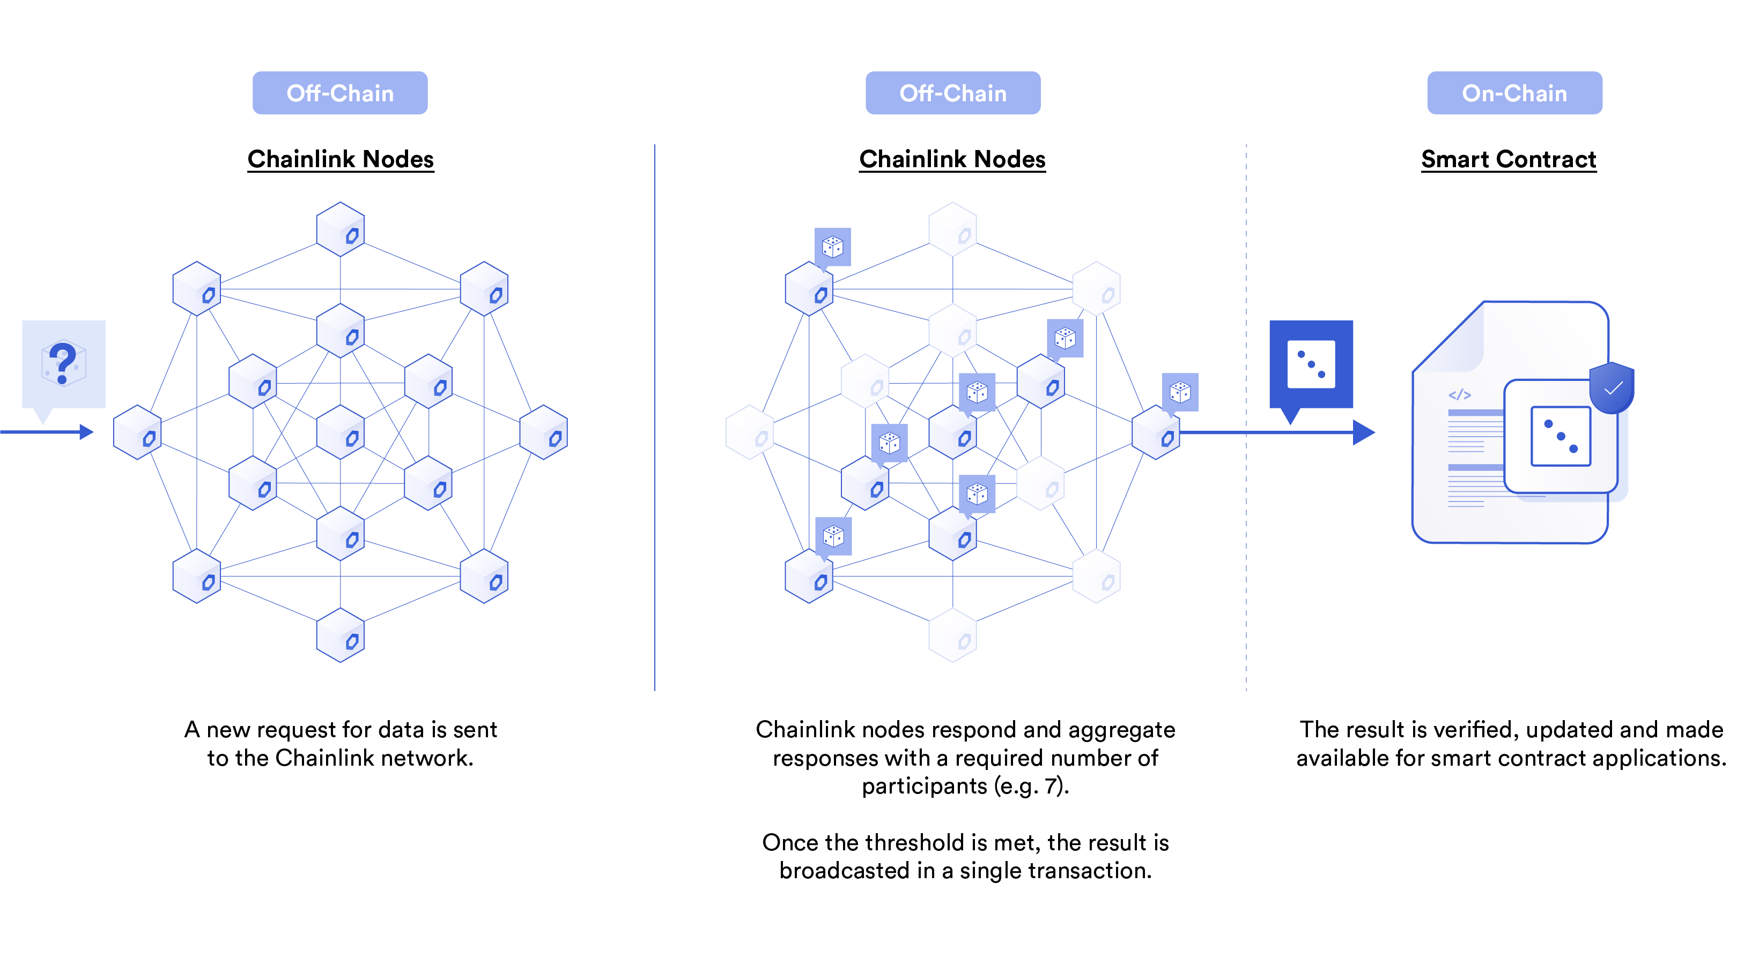

Slide 38
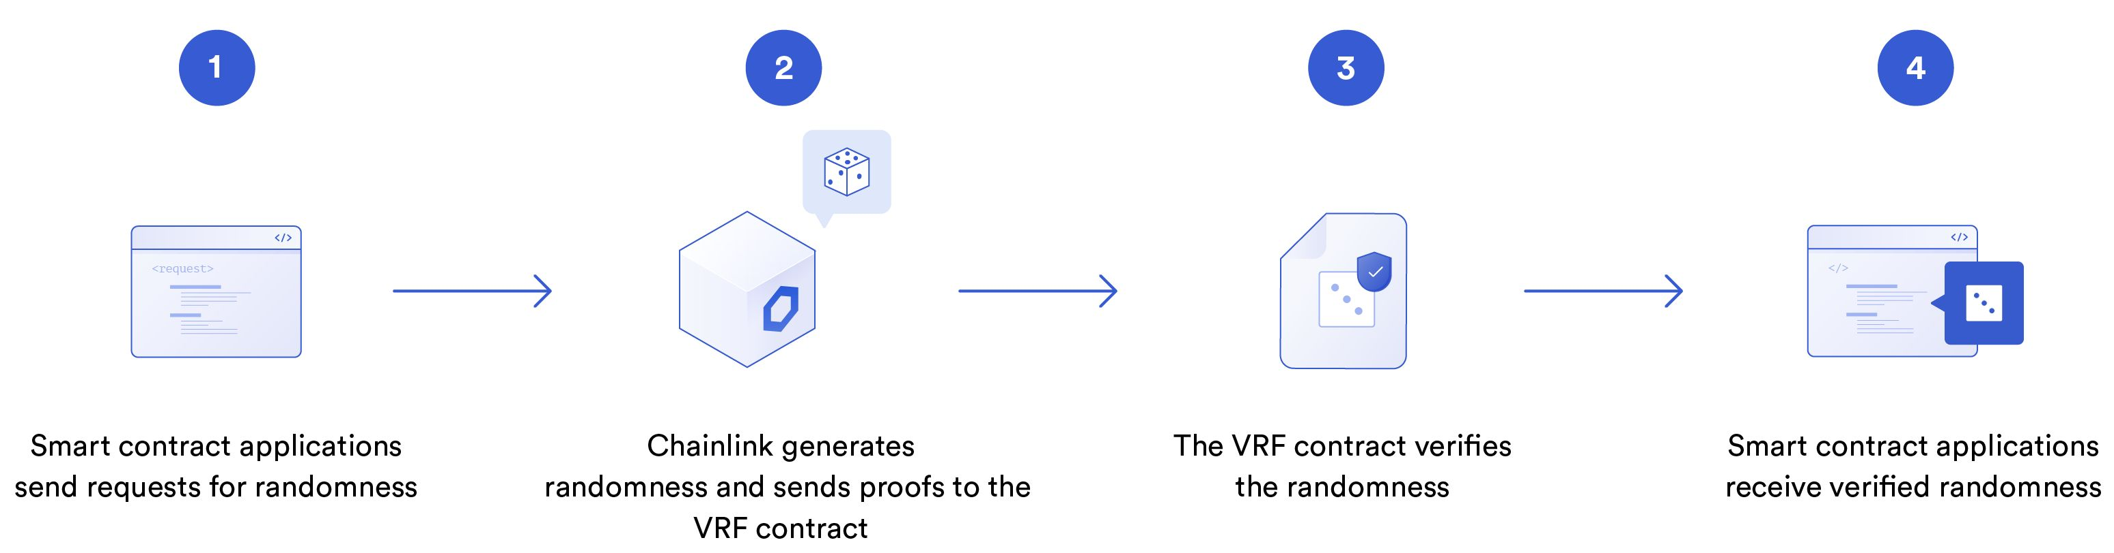
Chainlink VRF
Chainlink VRF, which utilizes verifiable random functions to generate randomness on-chain. That way it can be used by smart contracts developers as a source of the tamper-proof random-number generator.
It can be used by smart contracts in many applications such as NFTs, in blockchain games

Slide 39
Chainlink VRF
VRF works over a few transactions.
Here’s the sequence of events:
Your smart contract requests a random number from VRF, via transaction.
VRF generates that number and verifies it.
VRF prepares the response.
VRF then sends the number back to your contract, via another transaction.

Slide 40
Chainlink VRF
To consume randomness, your contract should inherit from VRFConsumerBase and define two required functions
requestRandomness, which makes the initial request for randomness.
fulfillRandomness, which is the function that receives and does something with verified randomness.
The contract should own enough LINK to pay the specified fee.

Slide 41
Creating Randomness with VRF
Create a contract that inherits from VRFConsumerBase
VRFConsumerBase comes with two functions vital to the VRF process.
The first is called requestRandomness which is already implemented, and which we don’t need to override. This is the function that makes the initial call to VRF.
The next is called fulfillRandomness, and this is the function which VRF calls back to when it has generated the number. We can override this to perform actions on the random number when it gets called.
The contract is simply going to store the generated random number in a state variable, called randomNumber, so that we can query it when it’s finished

Slide 42
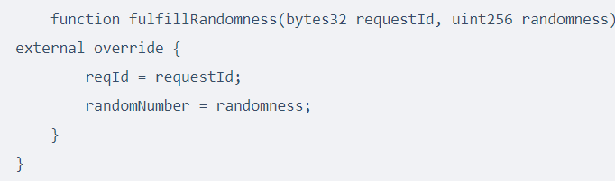
Creating Randomness with VRF
Callback function

Slide 43
Testnet Addresses
Rinkeby
https://docs.chain.link/docs/vrf-contracts/
When deploying the contract and calling the constructor, it needs the VRF coordinator address and the address of the LINK token on the network
Item | Value
LINK | 0x01BE23585060835E02B77ef475b0Cc51aA1e0709
VRF Coordinator | 0xb3dCcb4Cf7a26f6cf6B120Cf5A73875B7BBc655B
Key Hash | 0x2ed0feb3e7fd2022120aa84fab1945545a9f2ffc9076fd6156fa96eaff4c1311
Fee | 0.1 LINK

Slide 44
Tutorial
https://blog.coincodecap.com/how-to-generate-random-numbers-on-ethereum-using-vrf
https://blog.chain.link/random-numbers-nft-erc721/

